Slide 1
The picture for children and young people with mental health needs in London
Supporting the mental health of Londoners: A joint GLA and London Councils Member and officer event 11th July 2016
A
Dr Ann York
Child and Adolescent Psychiatrist and Clinical Advisor
Child and Young People’s Mental Health and Well-Being Programme, Healthy London Partnership

Slide 2
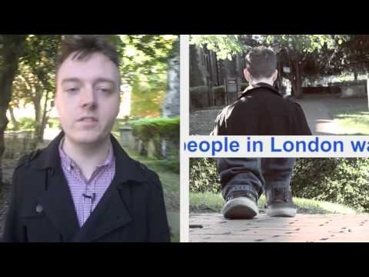
What do young people want from health services in London?

Slide 3
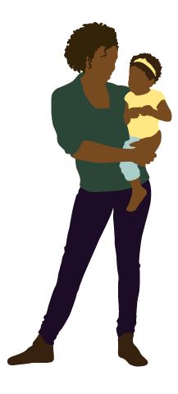
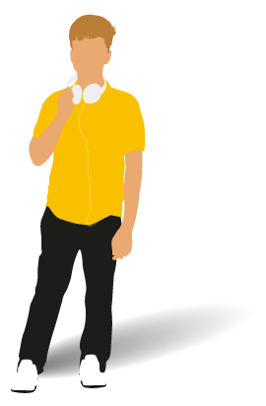



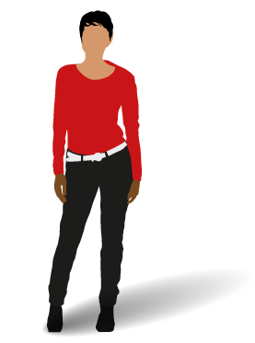
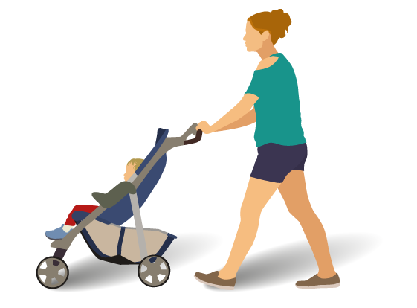
What do children, young people and families think?
I want to know that my GP is experienced in caring for children
We need easier access to healthcare
Make sure the school can look after my son when he has an asthma attack
Services are not joined up
I am worried about what will happen next year when I am too old for the children’s clinic
I need rapid access to someone I can talk to when I feel depressed

Slide 4
Children and Young People’s Mental Health:
National policy

Slide 5
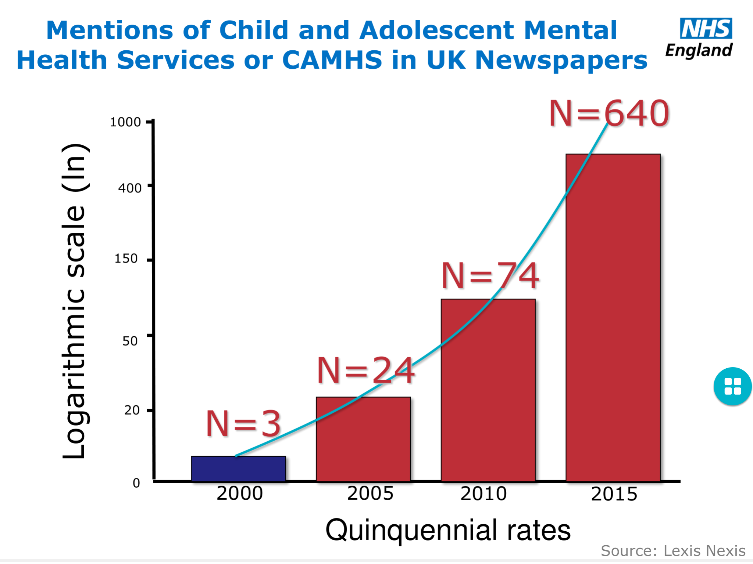

Slide 6
Stark facts
MOST MENTAL HEALTH DISORDERS START IN CHILDHOOD
75% of mental health disorders (not including dementia) start before the age of 18…. 50% before the age of 14 years
Most young people with mental health problems do not receive any help
Even if help is available, young people can be reluctant to seek help from services which still carry stigma and are not young person friendly
Adults and young people often suffer in silence
Many people do not realise there are effective treatments available- and if they do realise this they don’t know where to get help
1 in 4 young people say that the stigma of having a mental health problem has made them want to give up on life, and that most of that stigma comes from friends and parents.

Slide 7
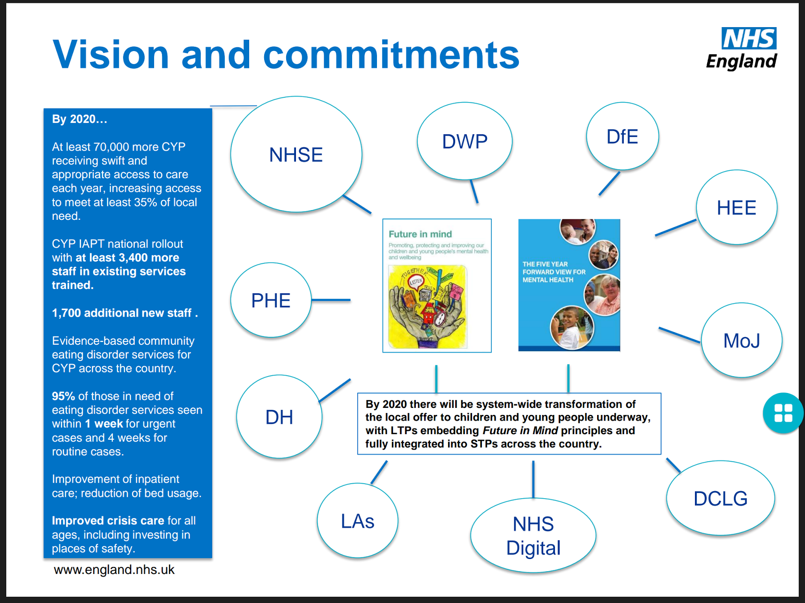

Slide 8
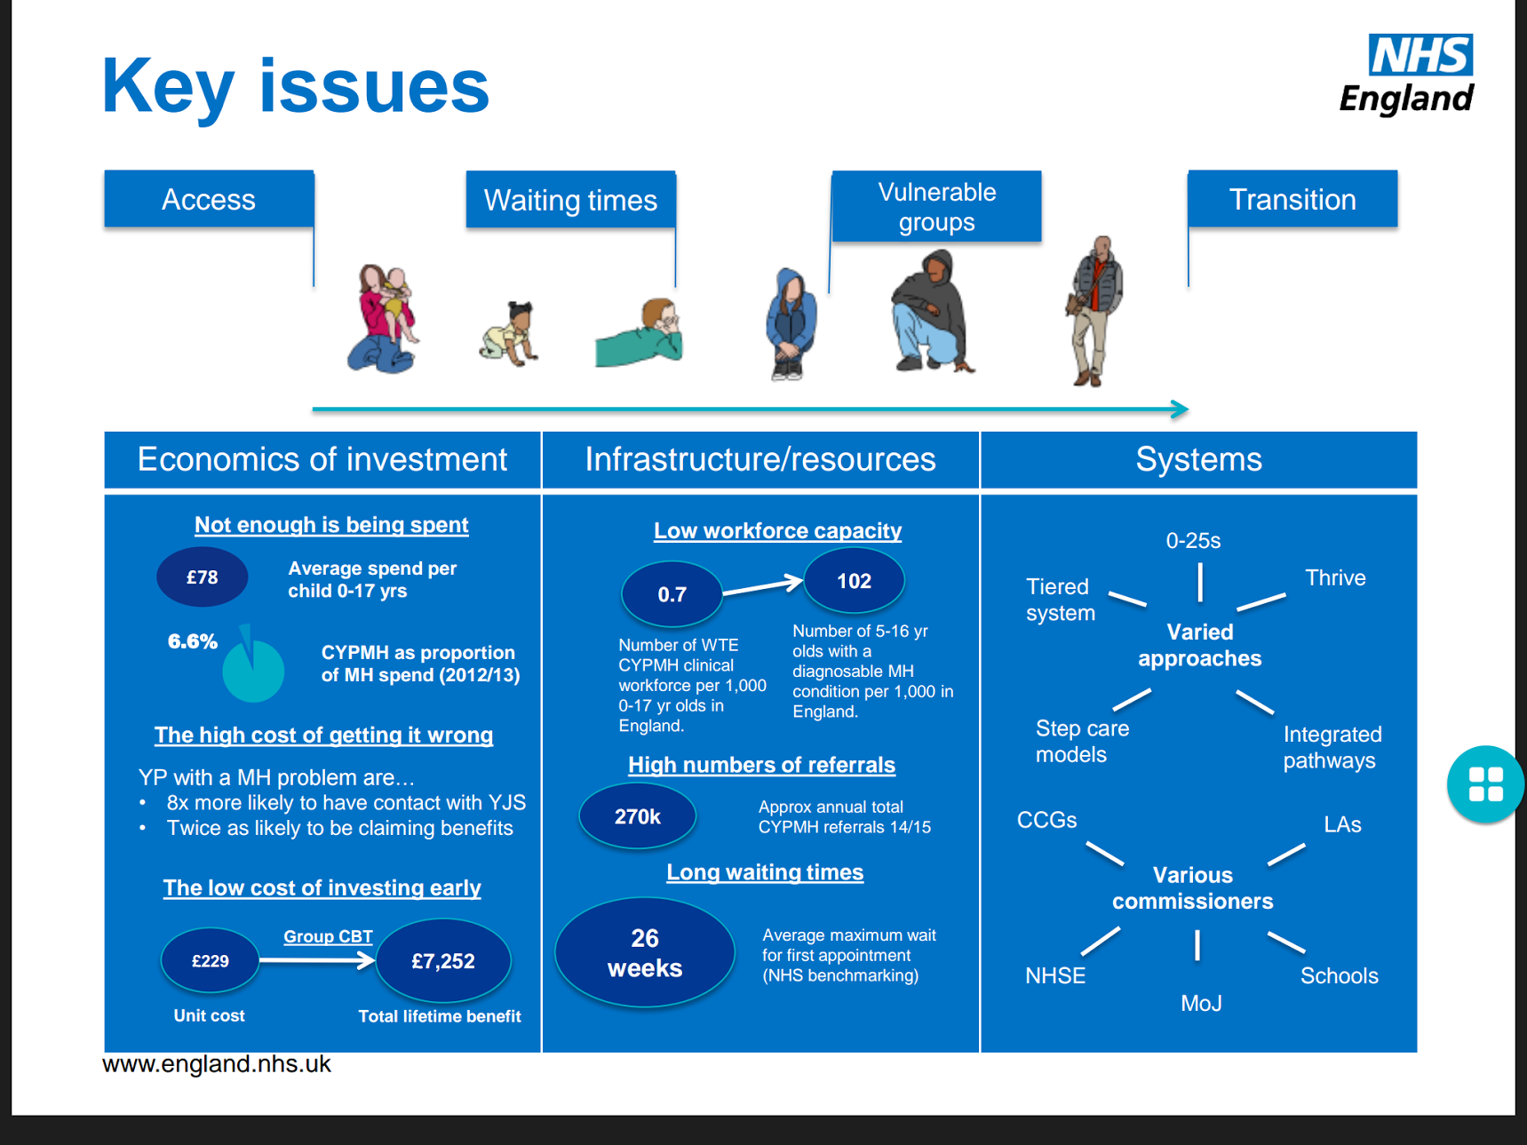
Title

Slide 9
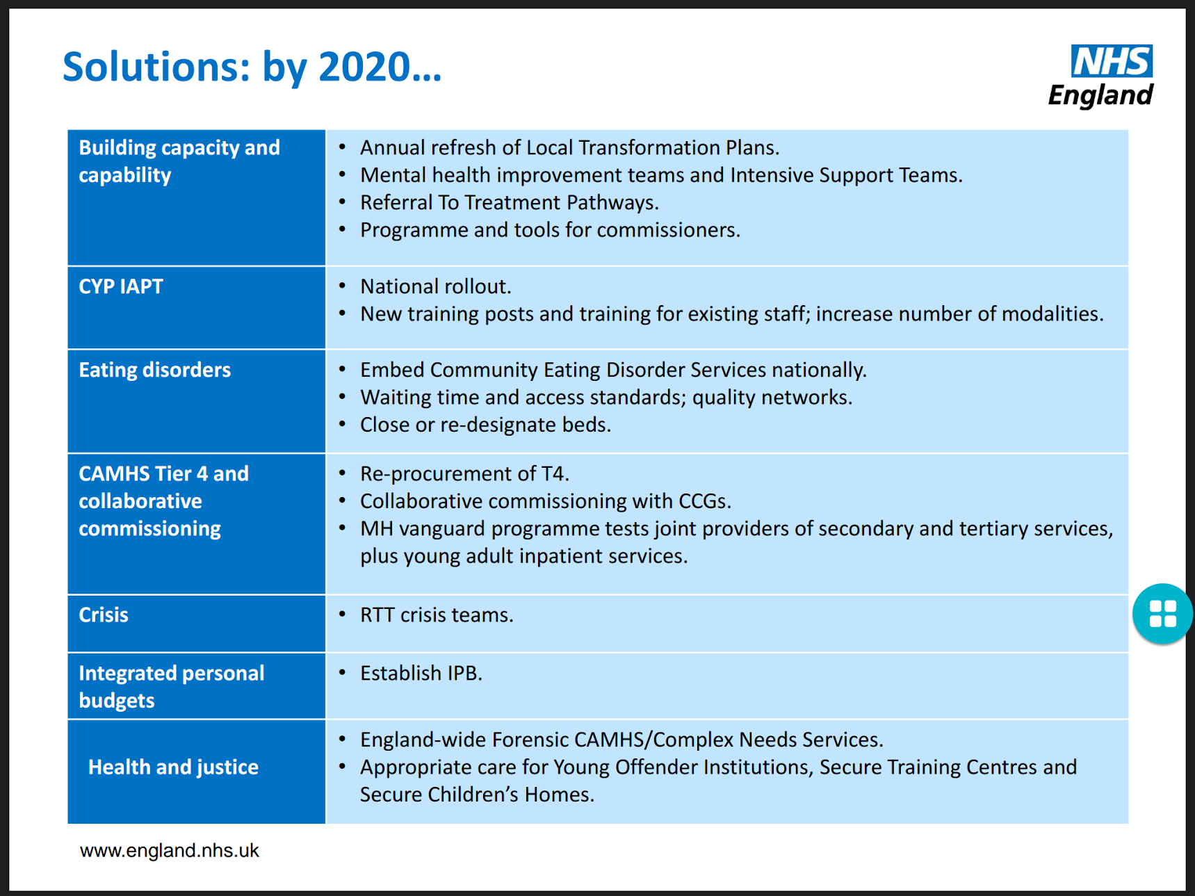

Slide 10
The Importance of Schools
Building resilience, identifying difficulties, supporting mental health

Slide 11
What is happening to support young people with mental health problems in London?

Slide 12


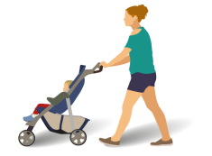


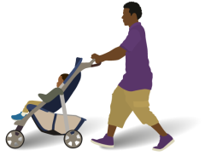


Healthy London Partnership –
Children and Young People’s programme
Children’s services in London: Key facts
8.2 million
people live in London
of which
20% of 4-year-olds are overweight or obese
2,049,576
are children aged 0-19
Mental Health conditions affect
1 in 8
Children
Emotional and
behavioural
problems affect
1 in 5
Children
600,000
of London’s children
live in poverty
25% of 15-year-olds
LESS THAN HALF
of 11-15
year olds do
an hour of
exercise each
day
134,186
live births in
London in 2012
First smoked
AGED 13 or younger
40%
of 15-year-olds
drink alcohol
once a week
20%
of 13-year-olds
drink alcohol
once a week

Slide 13
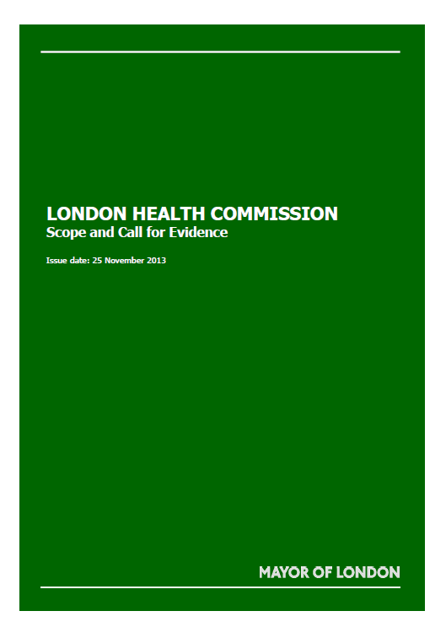
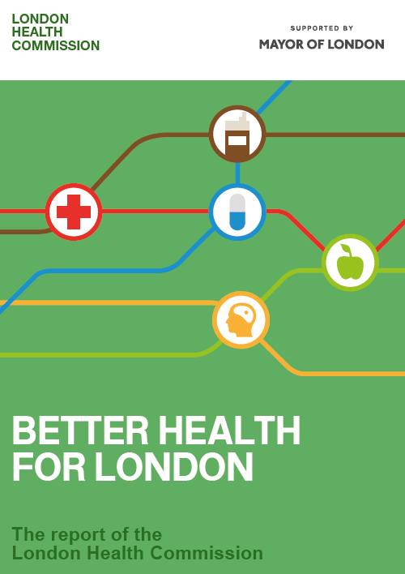


London Health Commission
Healthy London Partnership –
The delivery arm of the London Health Commission

Slide 14
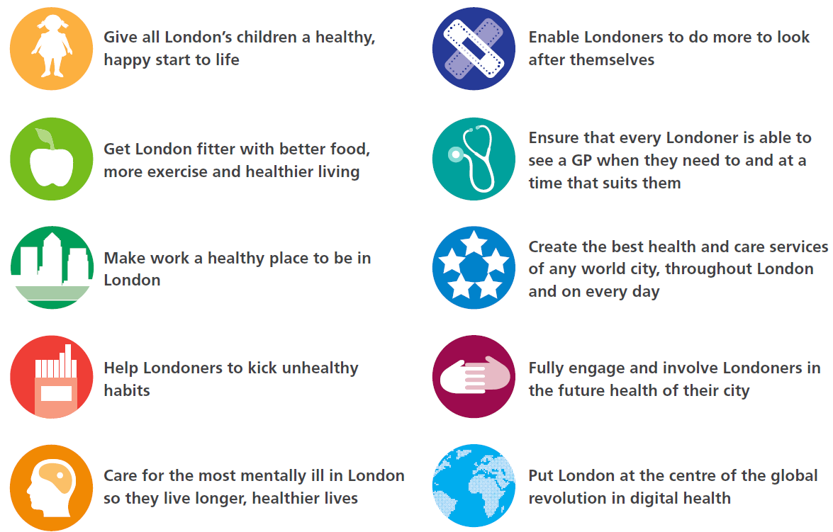
Goal – London to be world’s healthiest global city
10 programme aims from London Health Commission

Slide 15
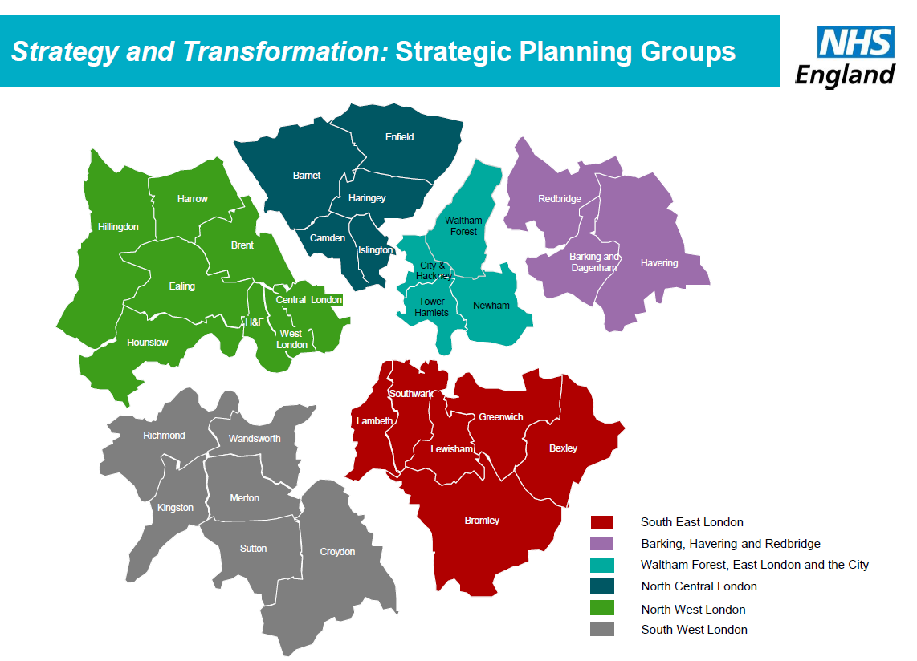
Each SPG and majority CCGs have lead for CYP

Slide 16
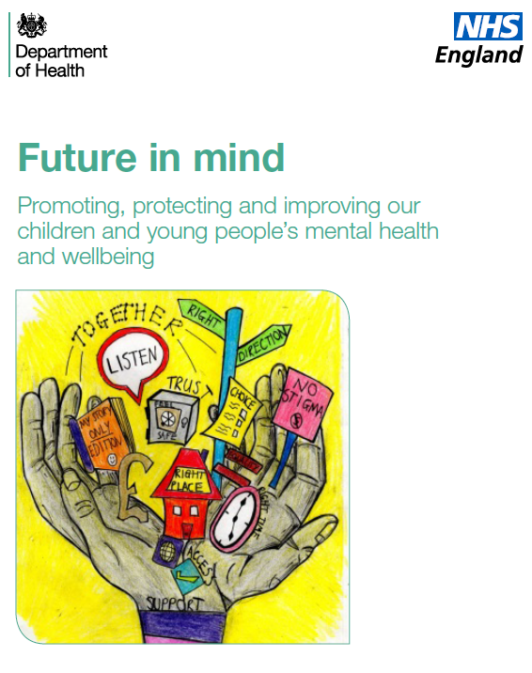
CYP Mental Health and Well Being
Supporting CCGs in developing and implementing local CAMHS transformation plans
Producing guidance and pathway for crisis care in conjunction with U and E care
Delivering workshops on specific areas of concern – eating disorders/learning difficulties/data
Working with DCO team to support assurance process
Working with voluntary sector to support collaboration with CCGs
Team expertise expanding – Clinical Advisor, Steve Ryan, CAMHS commissioners
Future work
Continue to support CCGs
Develop KPIs and informatics solutions
Linking in and supporting IAPT
Learning Disability/ASD
Transition to adult services
Working with schools

Slide 17
Work in schools
Example in Camden…
a universal approach to mental health promotion, emotional wellbeing and resilience
classroom and group interventions
targeted support
Jointly commissioned by Camden CCG and Camden Council CSF
Provided by the Tavistock & Portman NHS FT
A named CAMHS practitioner for every maintained mainstream school
Differentiated model of CAMHS outreach tailored to each school’s needs

Slide 18
CAMHS Transformation Plans
London CCGs developed 32 CAMHS Transformation Plans in 2015
Each plan outlined between 5 and 20 priorities for delivery in 2015/2016
Jointly developed between health, local authorities, children, young people and parents, schools, third sector

Slide 19
Top three investments (Q4 spend) in London’s 32 CAMHS Transformation Plans
Eating disorders (24)
CAMHS Access including Hubs and SPOA (19)
Schools (10)
Learning/neuro disability and ASD (12)
Crisis (7)
Upstream/drop-in (4)
Waiting list initiative (1)
IT/informatics/digital (5)
Planning/admin/strategy (5)
Evidence-base/IAPT (2)
£2 560 000
£1 940 000
£ 782 000
£ 764 000
£ 600 000
£ 430 000
£ 300 000
£ 292 000
£ 255 000
£ 300 000

Slide 20
North West London
A single plan investing £1.1 M developing new defined accessible (85% by March 2016) Community Eating Disorder Service
Family intervention at core and CBT and CBT-E
Strong links to primary care
Building proposition with current providers & professional and market-test in 2017

Slide 21
North Central London
Collaborative commissioning by 5 CCGs
Currently service good satisfaction and outcomes but only half seen in 4 weeks
Focus on capacity building
Training all Eating Disorder staff using CYP-IAPT
Outreach education
Telephone support to GPs

Slide 22
North East London
Now: Good access if low weight with rapid triage but ongoing monitoring and pre-therapy group during 12-16 week wait
Increase staffing 5 therapists and 0.3 WTE paediatrician to deliver through increased CBT-E, family therapy, IAPT and some alternatives
Funding of collaborative redesign and innovation

Slide 23
South East London
Need to get more accessible local delivery with neighbouring CCGs (7/7, telephone, self-referral)
Training backlog and limited resource
Plan for increased caseload by increase of cost and volume contract
New role to work on prevention with schools and Tier 2 support to Tier 1 dealing with emergent Eating Disorders

Slide 24
South Central London
Access already to new standards with strong links to paediatrics with 8 modalities of care
Want to focus more on multifamily therapy
Access to senior clinician 0830-1800 by phone
“Thinkbody” schools programme available to all year 7/8 pupils
Parent buddying/networking

Slide 25
South West London
5 CCGs building on presence of dedicated ED team
Meet waiting times by 2020; easier routes in
Increase CBT and Systemic Family Therapy and availability of day care
Provider outlined 3 levels of option – middle option preferred: responsive, paediatrics, single point of access, on-line, NICE compliant, multifamily therapy, intensified mealtime support

Slide 26
And finally

Slide 27
Mia’s Story
https://www.youtube.com/watch?v=k-J2ZAY7kos
West London Mental Health

Slide 28

Things we can all do
Watch this later…..

Slide 29
Contact me on
drannyork@gmail.com

